Slide 1
Notes:
<number>

Slide 2
2010: School 0
18th Journées de la Diffusion Neutronique (organized by SFN – French Neutron Society)
School ‘Neutrons et simulations’
Notes:
<number>

Slide 3
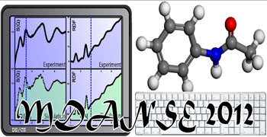
2012: MDANSE I
First school organized at ILL
3 days (March 2012)
30 participants
Goal: First introduction to simulation techniques (overcome activation energy and loose fear)
Notes:
<number>

Slide 4
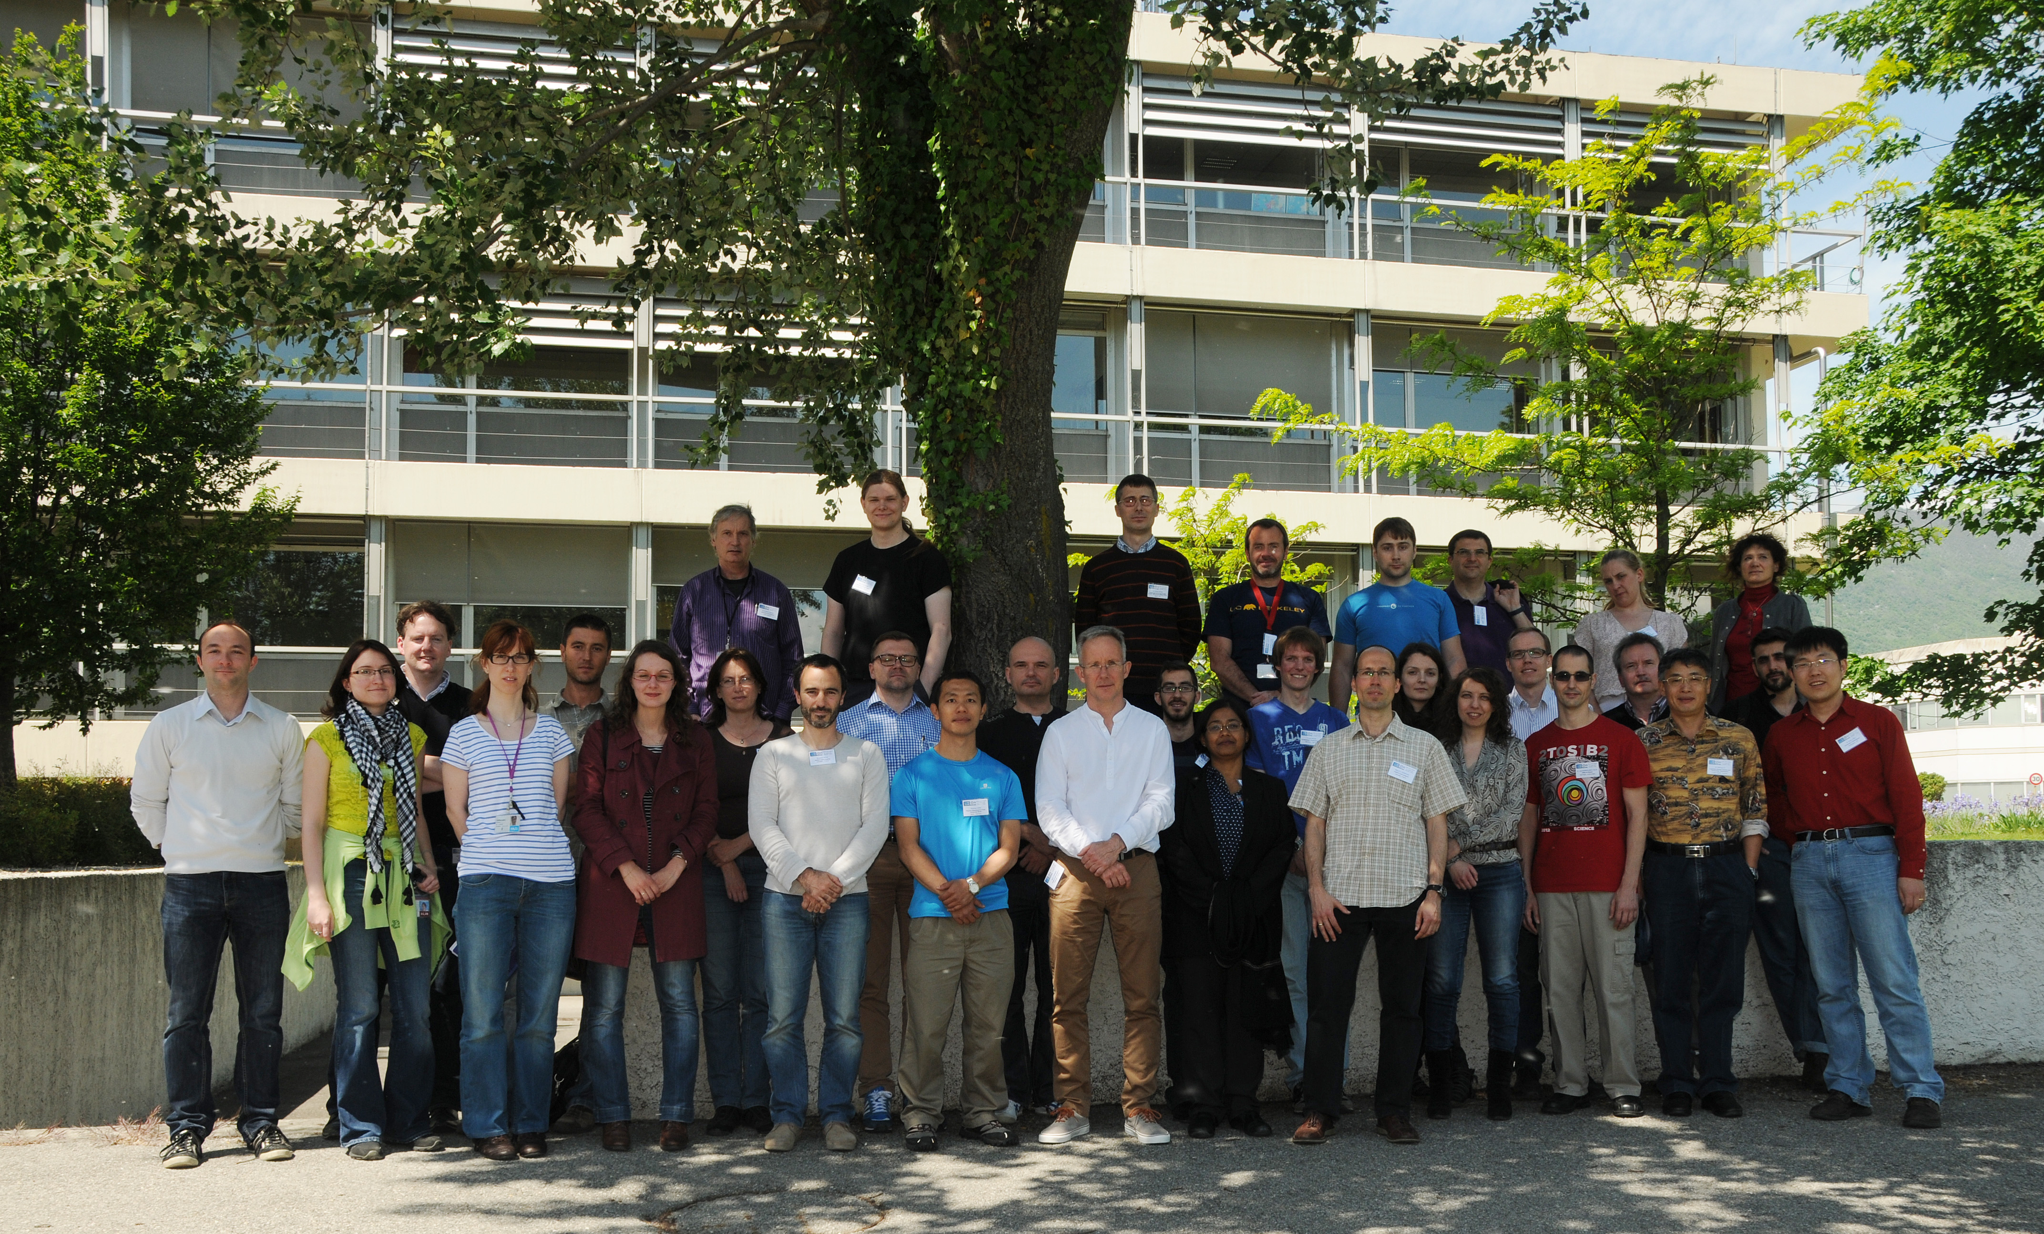
2014: MDANSE II
Satellite event of QENS-WINS conference in Autrans
2 days (May 2014)
Focus on QENS and inelastic neutron scattering
Notes:
<number>

Slide 5
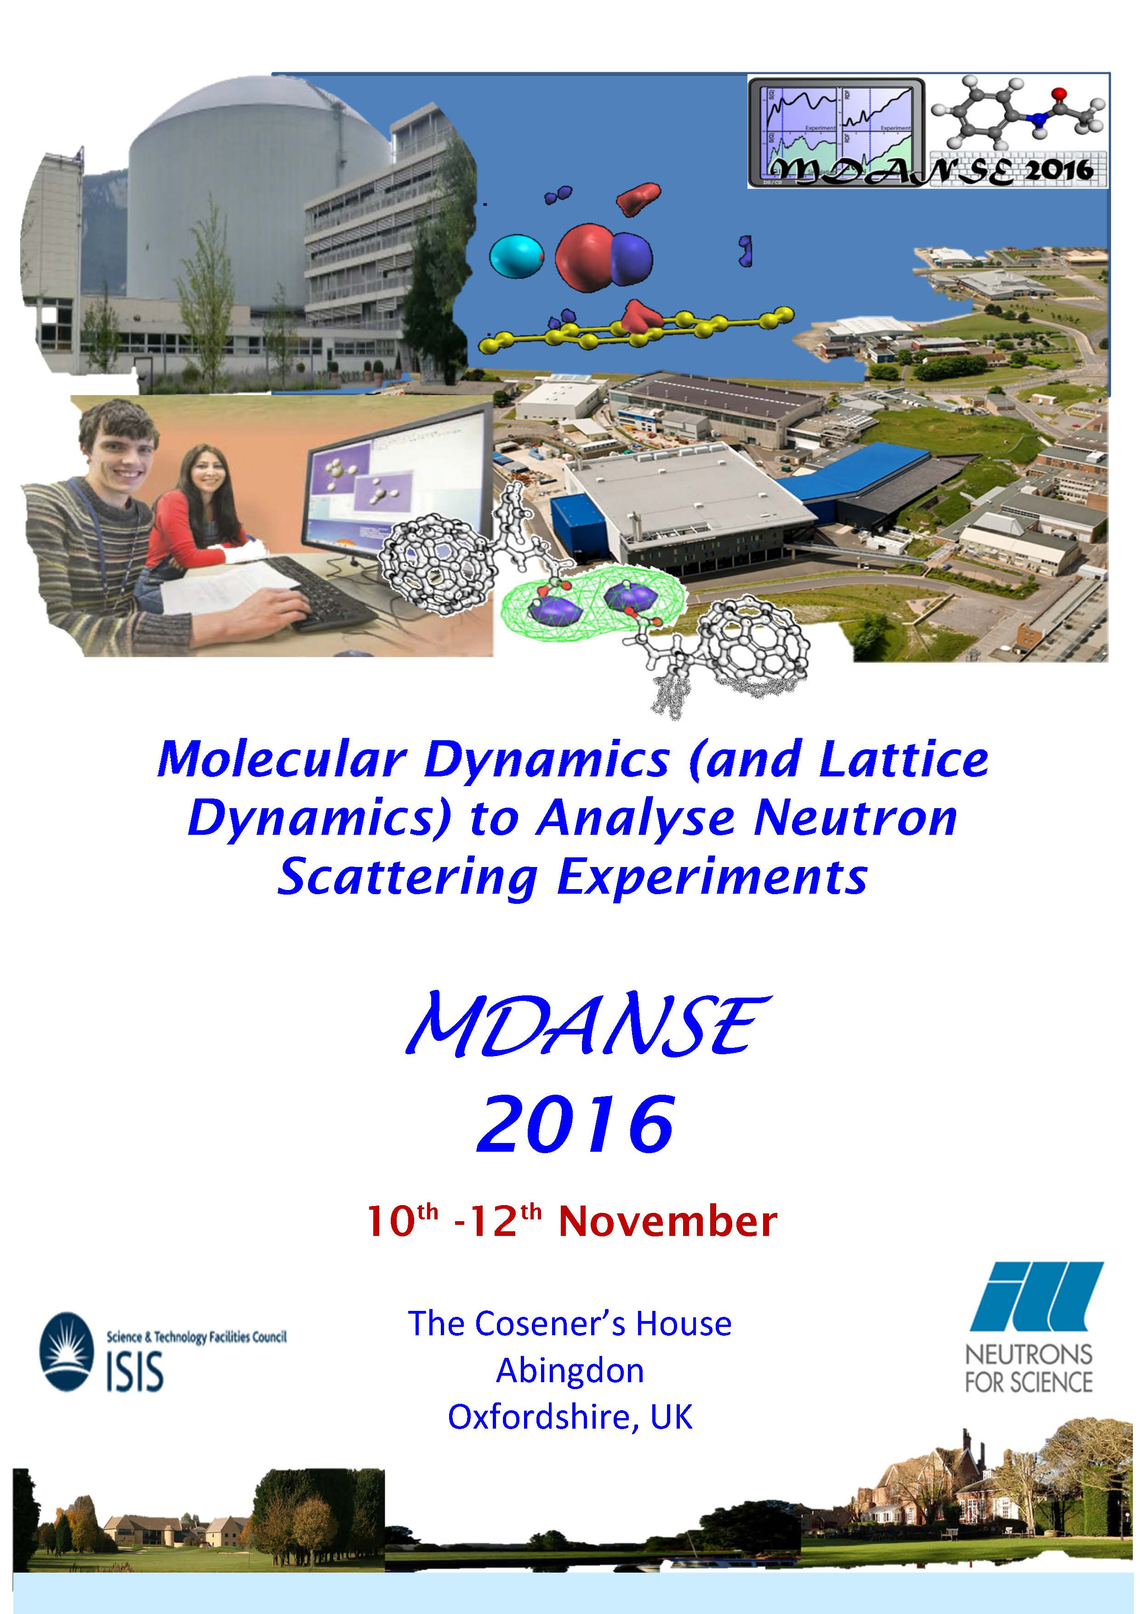
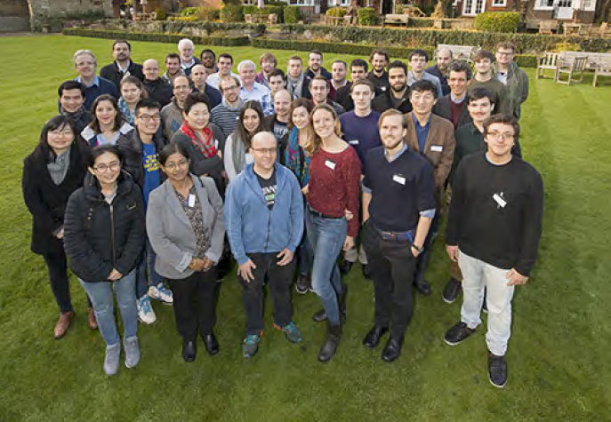
2016: MDANSE III
Co-organized by ILL and ISIS
2 days (November 2016)
Included some advanced topics
Proceedings: RAL-TR-2016-018
Notes:
<number>

Slide 6





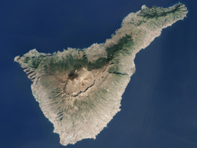
2018: MDANSE IV
Organizers/lecturers:
Emmanuel Farhi (ILL)
Sanghamitra Mukhopadhyay (ISIS)
Peter Willendrup (ESS/DTU)
Thomas H. Rod (ESS)
Erik Knudsen (DTU)
Miguel A. Gonzalez (ILL)
Felix Fernandez-Alonso (ISIS)
Jon Taylor (ESS)
1 week
Intro to simulation → Virtual experiments
Notes:
<number>

Slide 7
2018: MDANSE IV
(My view)
Still a school:
Some (few) lectures
Plenty of time for hands-on practicals and discussions
Do not hesitate to ask questions and request help
But also kind of a workshop:
We are all exploring ways of facilitating the integration of simulation tools with experiment
Discuss, tell us what tools you use, which things work or not, …
Propose alternative ways of doing, applying, and analyzing simulations
Notes:
<number>

Slide 8
Learn, share, enjoy!
Notes:
<number>

Slide 9
Organizers
E. Farhi (ILL)
M. A. Gonzalez (ILL)
S. Mukhopadhyay (ISIS)
T. Rod​ (ESS/DMSC)
P. Willendrup (ESS/DTU)
E. Knudsen (DTU)
J. Taylor (ESS/DMSC) [excused]
F. Fernandez-Alonso (ISIS) [excused]
Contact: mdanse2018@ill.fr
http://mdanse2018.essworkshop.org/

Slide 10






Made possible with
Your generous registration !
SINE2020 (Grant 654000-SINE2020- H2020-INFRADEV-2014-2015/H2020-INFRADEV-1-2014-1)
ISIS
ILL
DTU
ESS
<number>

Slide 11
